Slide 1
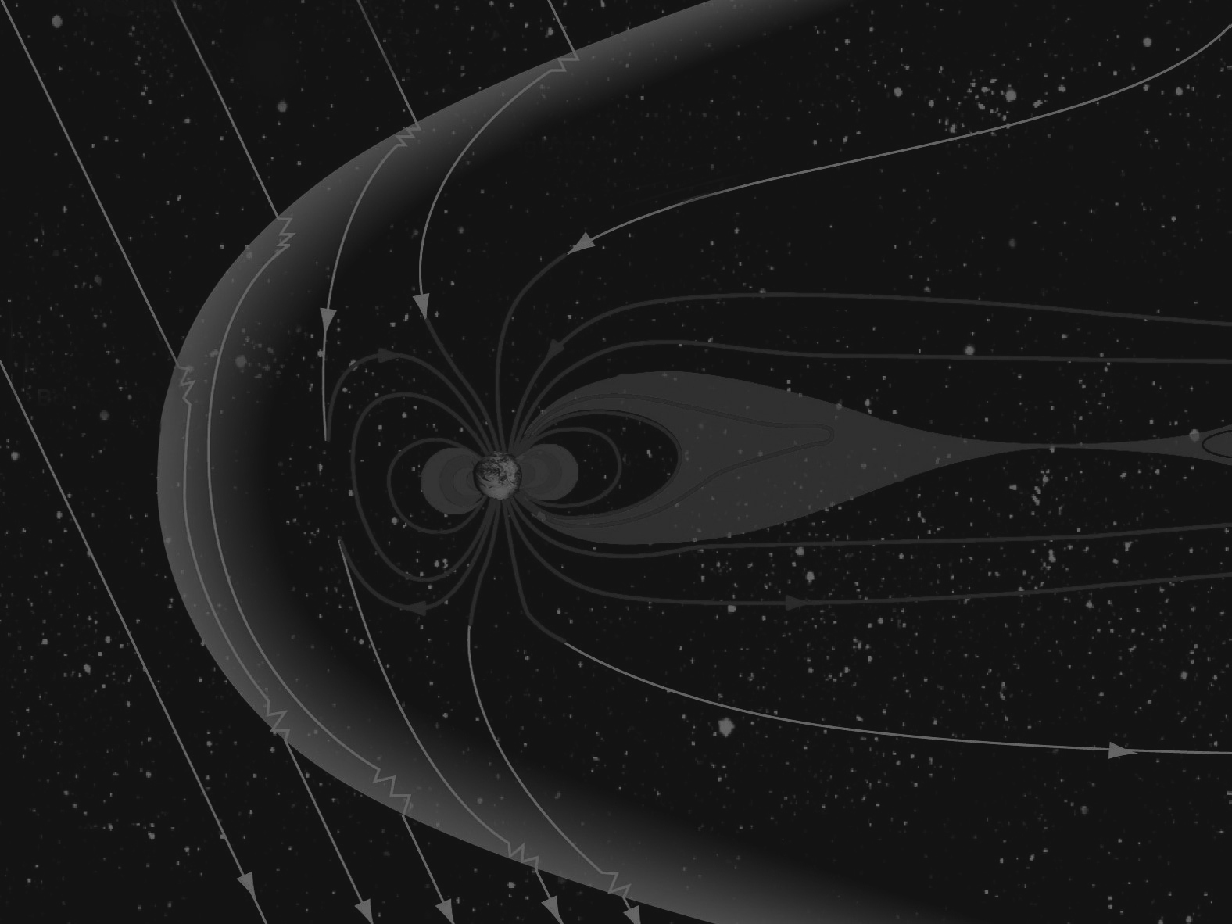
Earth’s Magnetosphere: Plasma accelerations outside the magnetotail
Claire Kuang
Mentor: Dr. David Sibeck

Slide 2
How are plasma accelerations generated?
Field lines that encounter the magnetopause are temporarily slowed and stretched
Results in a ‘sling shot’ effect in plasma further down as lines are pulled along the sides

Slide 3
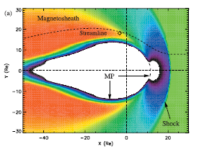
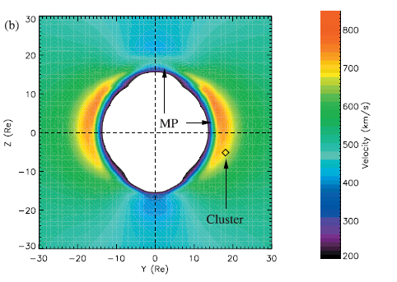
Current research: Lavraud
Strong accelerated flows in the magnetosheath that equal or exceed solar wind velocity
Strong bulk plasma acceleration in Earth’s magnetosheath:
A magnetic slingshot effect?
B. Lavraud, published 18 July 2007.

Slide 4
My research: using magnetohydrodynamic models in CCMC’s database
z
Community Coordinated Modeling Center
Dayside reconnection line data from last summer
Identify locus of points from which accelerated flows diverge for each IMF angle parameter
Relate flows to reconnection line tilt
y
x
0°
45°
y
90°
135°
z

Slide 5
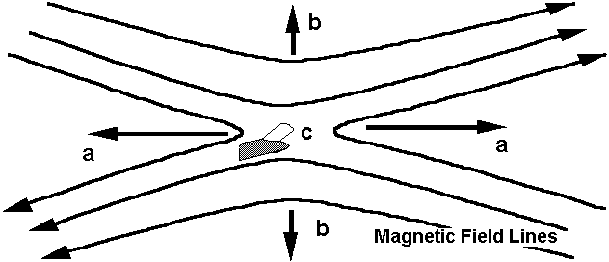
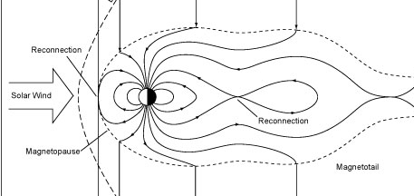
What is reconnection?
Reconnection occurs at the boundary between two different magnetic fields
Transfers energy from the sun into the magnetosphere

Slide 6
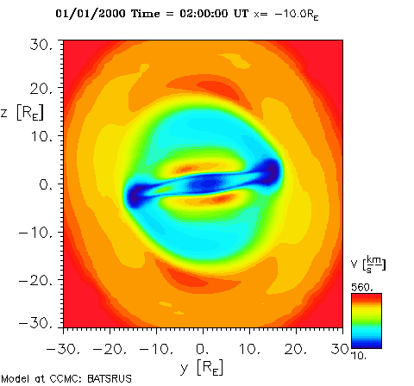
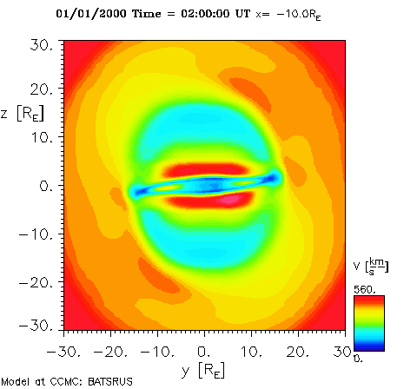
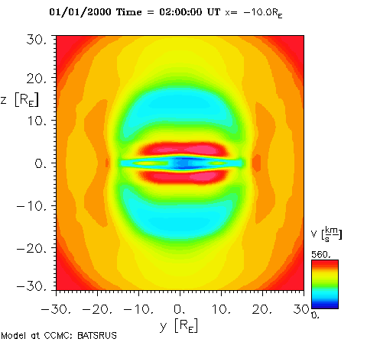
IMF angle = 90
IMF angle = 135
IMF angle = 180
IMF = 135

Slide 7
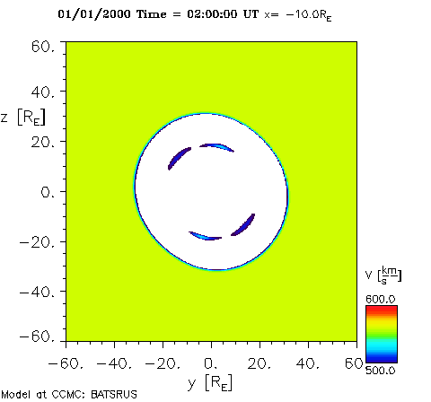
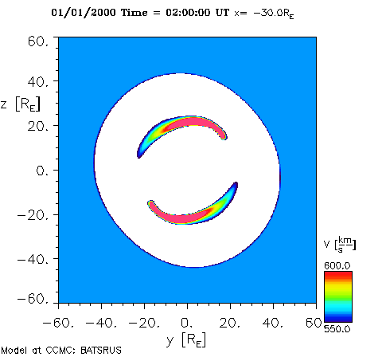
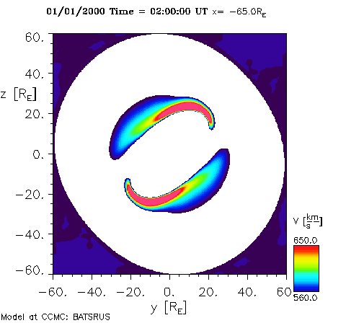
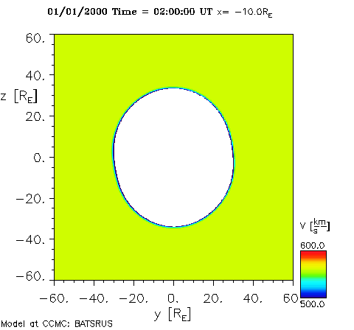
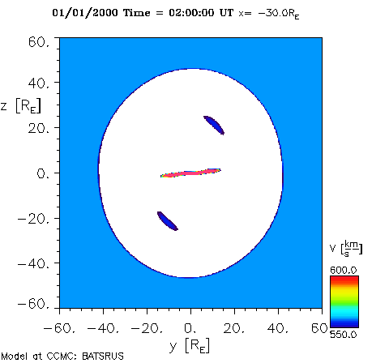
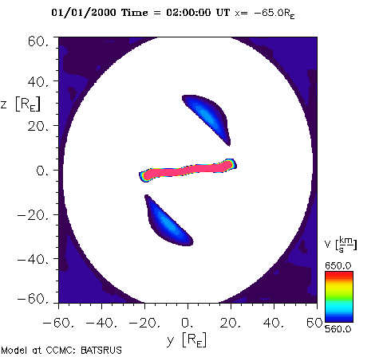
IMF = 45
IMF = 135
IMF = 135

Slide 8
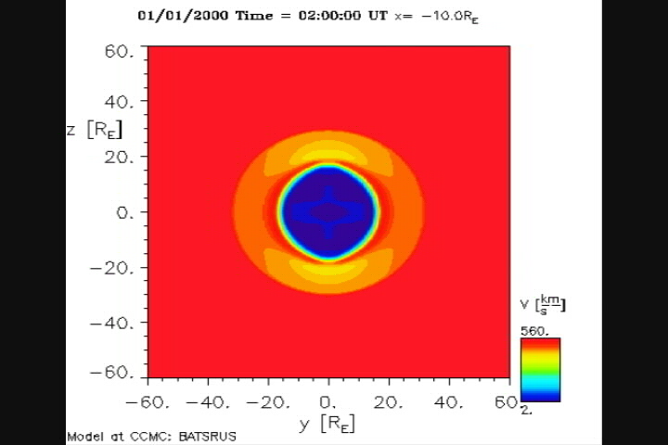
IMF angle rotates from 0 (north) to 90 (dusk)
IMF = 135

Slide 9
Conclusion
Locations of accelerated flows outside the tail consistent with reconnection line tilt
Flow velocity only exceeds solar wind velocity for
distances greater than 10 Re tailward from Earth
southward IMF clock angles

Slide 10
Thanks to:
Dr. David Sibeck and Masha Kuznetsova
Dr. Ekaterina Verner
SESI and Catholic University

